Slide 1

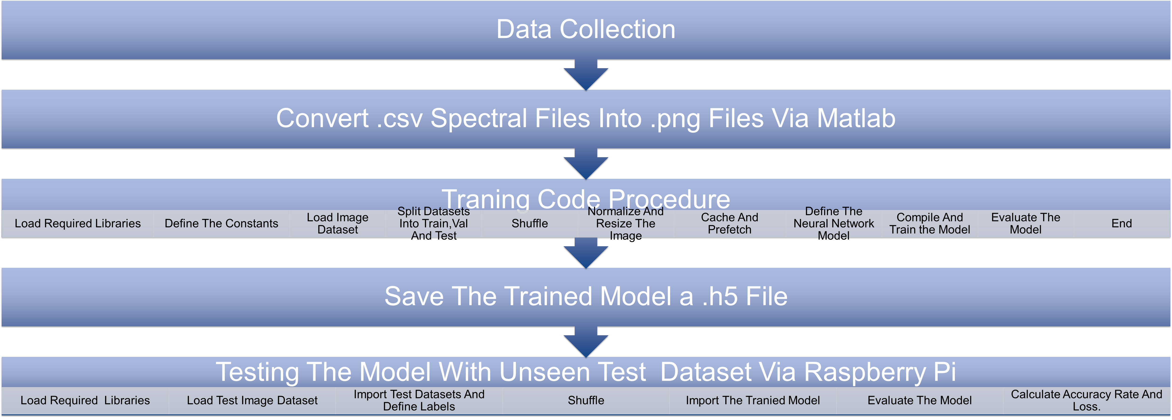
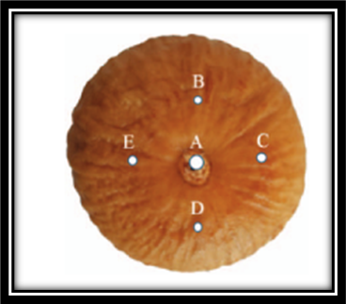
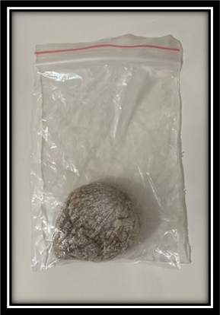
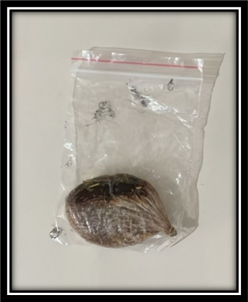
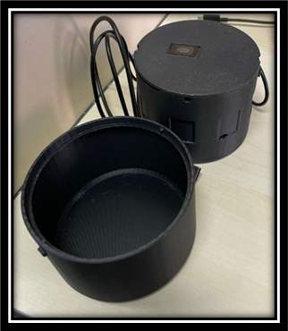
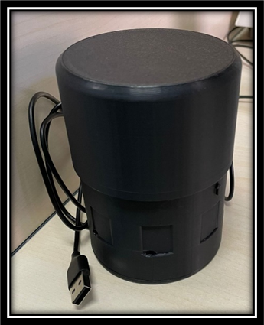
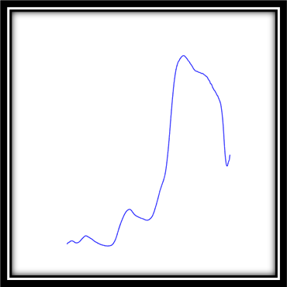
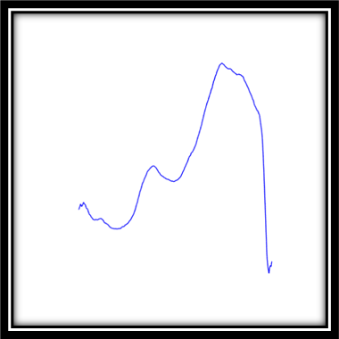
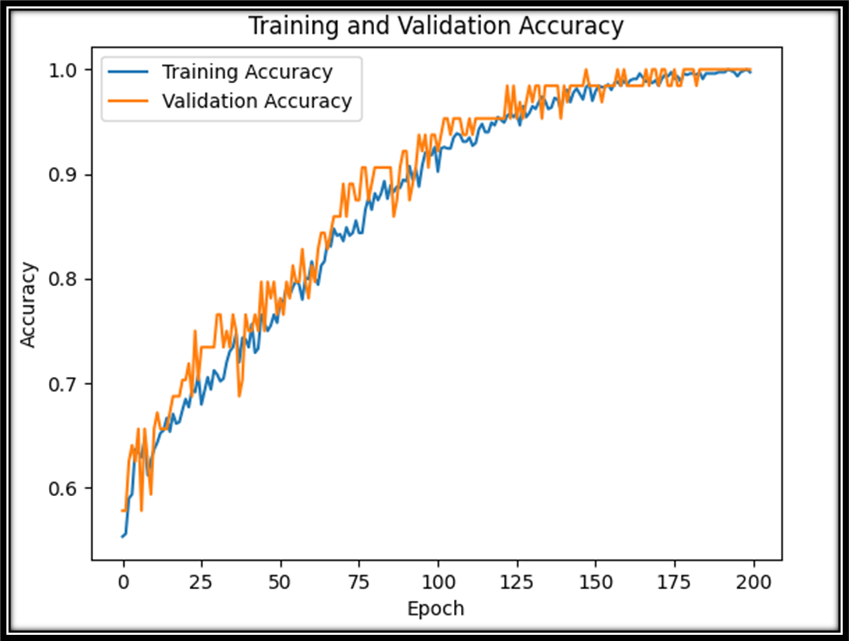
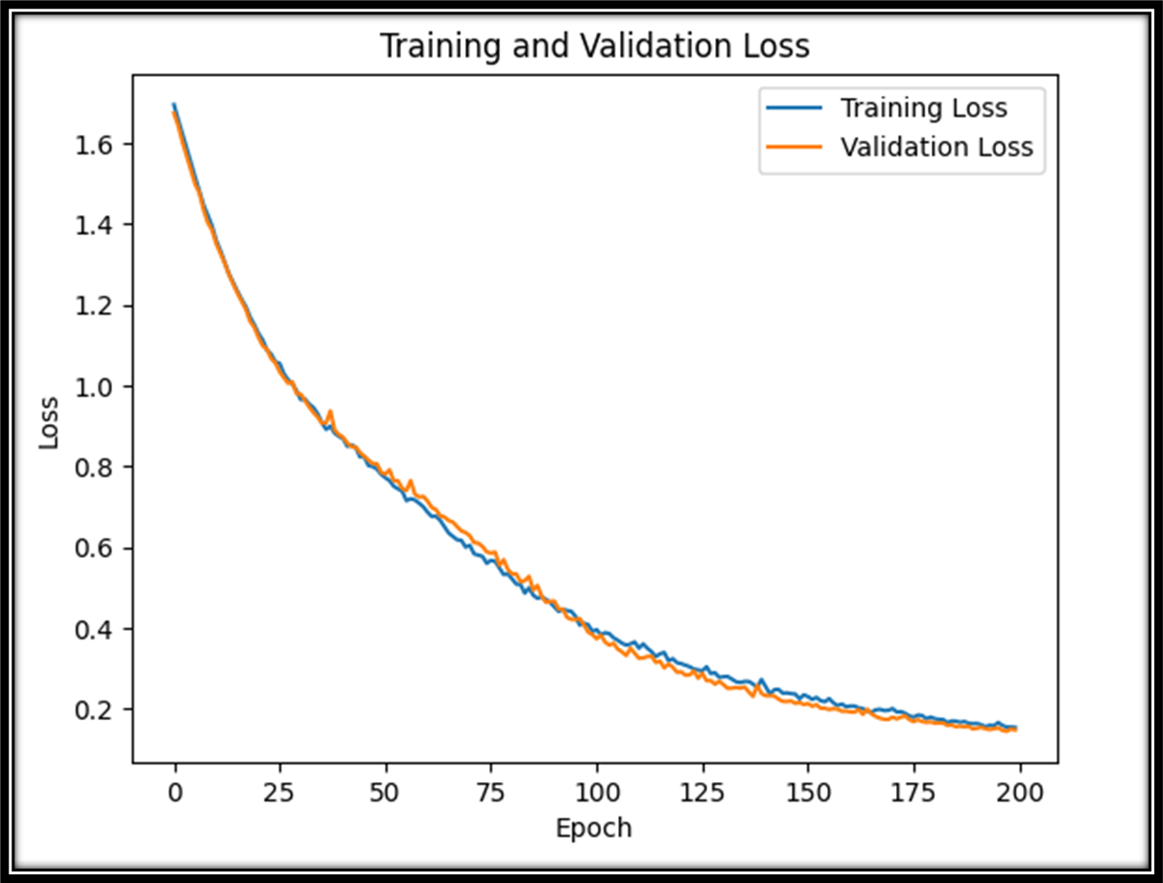
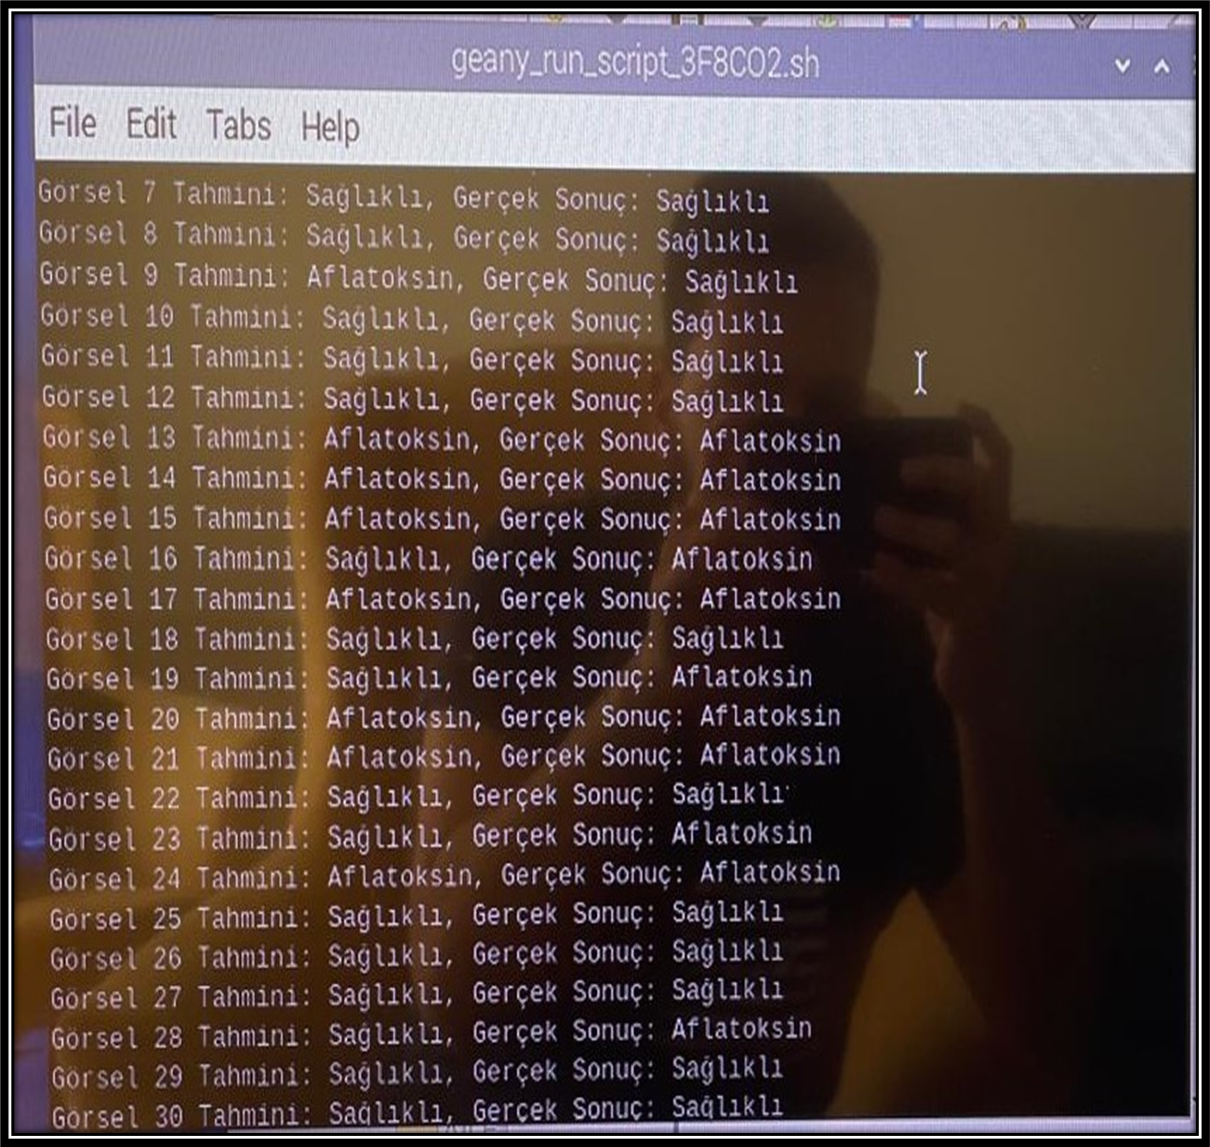
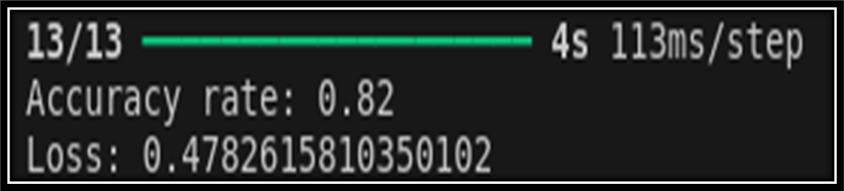
Detection of mycotoxins in dry fig using NIR scan with AI-based methods
Emre Öztürk
Yeditepe University, Istanbul, TURKEY, emre.ozturk6@std.yeditepe.edu.tr
Supervisor: Asst. Prof. Dr. İpek Baz
Yeditepe University, Istanbul, TURKEY, ipek.baz@yeditepe.edu.tr
INTRODUCTION
Due to its high sugar content and the structure of its skin, which facilitates the penetration of aflatoxins, dried fig is particularly susceptible to aflatoxin contamination. Levels of contamination can be worryingly high, posing significant health risks.
The detection and quantification of aflatoxins typically involve costly and time-consuming methods such as liquid chromatography (LC) and high-performance liquid chromatography (HPLC), despite their accuracy. Immunological methods like ELISA offer faster alternatives, but they come with accuracy and cross-reactivity issues.
The need for non-destructive, rapid, and accurate detection methods is increasing. Techniques like near-infrared spectroscopy (NIR) hold promise due to their speed and sensitivity. Operating in the 900-1800 nm range, NIR is suitable for detecting aflatoxin contamination in food products, providing reliable and safe data without requiring extensive sample preparation.
DESIGN
METHODS
Preparation of the Dataset
İpek Baz provided 1.5 kg of fig samples for experiments: 0.5 kg contaminated with aflatoxin and 1 kg healthy. Experts divided the samples into two groups based on UV light: aflatoxin-contaminated and healthy. 14 aflatoxin-contaminated and 25 healthy figs will be measured. Fifty spectral data points were taken from each side of the aflatoxin-contaminated figs, and 28 spectral data points were taken from different points on each side of the healthy figs. In total, there are 1400 data points: representing 700 aflatoxin-contaminated and 700 healthy figs.
Options for NIR
NIR scanning with Nano has been tested with various parameters, including resolutions of 228 and 352 and scan numbers of 20 and 40. It was observed that the best result was obtained with 20 epochs and 228 resolution. Trials were conducted with white and black backgrounds during measurements with the NIR device. However, it was observed that the reflected light or ambient light in the room hindered obtaining accurate results during measurements. Therefore, the inappropriate measurement environments also posed a problem. To address this issue, a special box design was used.
Spectroscopic Measurements
After a comprehensive review of the literature and experiments, it was determined that the spectrometer wavelength range of the DLP NIR scanning nano measurement device is between 900-1800 nm. Spectral data were found to be recorded in three different formats: absorption, reflection, and intensity. Subsequently, the most effective classification for dried figs was achieved using absorption values.
Training of Deep Learning Models
The spectral data collected with the NIR device were converted into .png images through appropriate procedures. Each image represents the absorption of light at different wavelengths. Pre-processing steps such as normalization and resizing were applied to the obtained .png images. Additionally, data augmentation was performed.
Eighty percent of the collected data were allocated for training, 10% for validation, and the remaining 10% for testing. The parameters, layers, hyperparameters, and optimizer configurations of the model were optimized for the best performance.
Dried Figs with Aflatoxin Absorbance graph
Healthy Dried Figs with Absorbance graph
RESULTS
The model was tested in both the Colab environment and on a Raspberry Pi using 400 unseen data points, saved as an H5 file. The accuracy rate was determined to be 82%, with a loss value of 0.48%.
During training, the loss consistently decreases while accuracy increases. Validation accuracy generally increases as well, with minimal fluctuations in some epochs. The loss and validation loss graphs exhibit simultaneous, smooth, and regular declines. The best-performing model achieved a training accuracy of %97.79 and a loss value of %0.2005.

